Slide 1
WEEK 5
Feature Engineering II
From expert knowledge to production-ready features
Day 21
Domain-Driven Features
Ratio features, per-unit metrics, business logic encoding
Day 22
Interaction Features
Multiplicative, additive, logical interactions
Day 23
Polynomial Features
Non-linear expansion, degree selection, regularization
Day 24
Feature Selection
Variance threshold, correlation, redundancy removal
Day 25
Mini-Project
End-to-end feature engineering with documentation
DOMAIN-DRIVEN EXAMPLE
df["price_per_sqft"] = df["price"] / df["sqft"]
df["revenue_per_user"] = df["revenue"] / df["num_users"]
# Transform raw data into meaningful ratios that encode domain knowledge

Slide 2
DAY 21
Domain-Driven Features
Ratio Features, Per-Unit Metrics, Business Logic
OBJECTIVES
ACTIVITY
• Translate business logic into features
• Create meaningful ratios and per-unit measures
• Understand model responses to domain features
• Identify risks: leakage, overfitting, bias
• Validate domain features empirically
Engineer price_per_sqft feature.
Extend pattern to other domain-specific metrics.
ASSESSMENT
Justify each feature in terms of domain intuition and model behavior.
Week 5 · Feature Engineering II

Slide 3
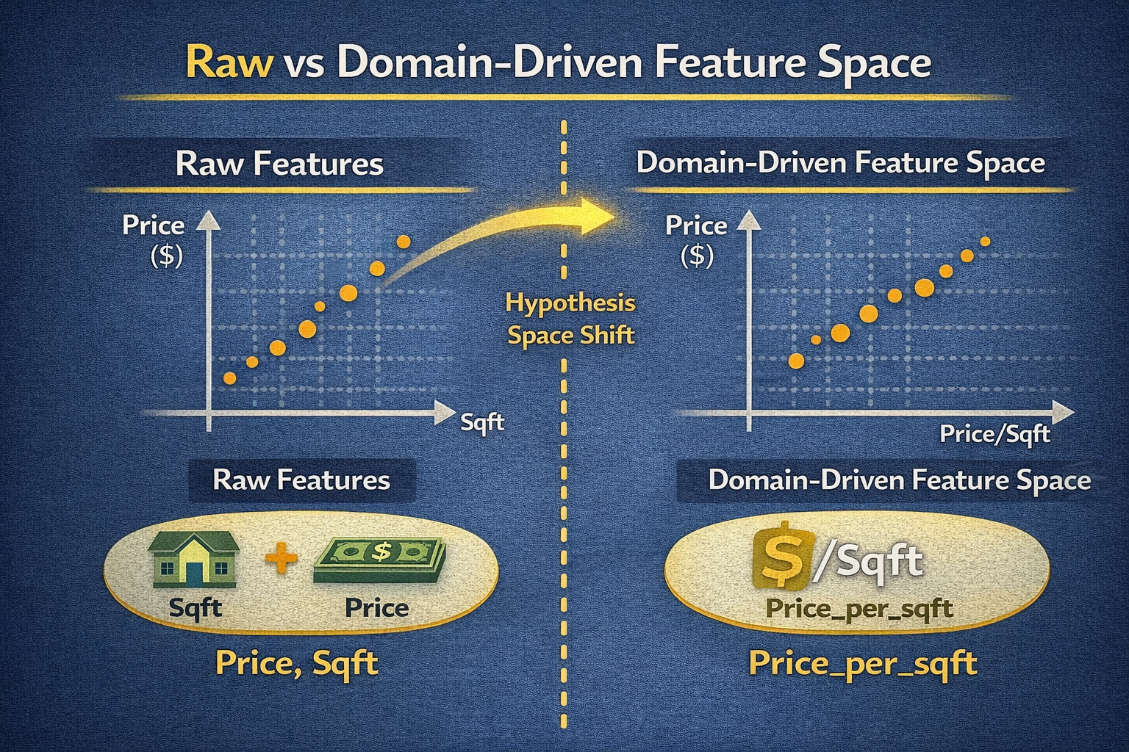
DAY 21 · DOMAIN-DRIVEN
What Are Domain-Driven Features?
Variables intentionally constructed using domain knowledge
Definition
Why They Matter
Features grounded in how human reason about efficiency, intensity, or value
Examples:
• price_per_sqft in real estate
• revenue_per_user in business
• lab_result_ratios in healthcare
• Reshape hypothesis space to match real-world decisions
• Models express relationships in more meaningful, low-dimensional structures
• Improve sample efficiency and interpretability
RAW VS DOMAIN-DRIVEN FEATURES
X_raw = df[["price", "sqft"]] # Raw features only
df["price_per_sqft"] = df["price"] / df["sqft"] # Domain-driven ratio
X_domain = df[["price", "sqft", "price_per_sqft"]] # Enhanced feature set

Slide 4
DAY 21 · DOMAIN-DRIVEN
Why Raw Features Are Often Insufficient
Raw data reflects storage, not decision-making
The Problem
The Solution
• Two houses with same price but different sqft are not equally expensive to buyers
• Buyers compare cost per unit area, not absolute price
• Models must implicitly learn these ratios from data
• Explicitly engineer domain-driven features
• Bake relevant invariances into feature space
• Easier for linear and non-linear models to approximate true process
LINEAR MODEL COMPARISON
df["price_per_sqft"] = df["price"] / df["sqft"]
df["quality_score"] = 0.5 * df["price_per_sqft"] + noise
model_raw = LinearRegression().fit(df[["price", "sqft"]], y)
model_domain = LinearRegression().fit(df[["price_per_sqft"]], y)
print("R² raw:", model_raw.score(...), "R² domain:", model_domain.score(...))

Slide 5
DAY 21 · DOMAIN-DRIVEN
Translating Business Logic Into Features
Convert qualitative expectations into quantitative features
Process
Domain Examples
1. Identify numerator (quantity of interest)
2. Identify denominator (scale or resource)
3. Apply relevant transformations (log, clip)
4. Validate empirically and refine
• E-commerce: conversion_rate_per_marketing_dollar
• Logistics: on_time_deliveries_per_route
• Operations: delay_minutes_per_shipment
BUSINESS METRICS
df["orders_per_dollar"] = df["orders"] / df["ad_spend"]
df["on_time_rate"] = df["shipments_on_time"] / df["total_shipments"]
df["log_orders_per_dollar"] = np.log1p(df["orders_per_dollar"]) # Stabilize variance

Slide 6
DAY 21 · DOMAIN-DRIVEN
Ratio Features — Definition and Intuition
One quantity relative to another: efficiency, intensity, density
What Ratios Capture
Model Benefits
• price / sqft → cost per unit utility
• revenue / users → value per customer
• clicks / impressions → engagement rate
Decision-makers compare these, not raw counts
• Reduce collinearity between raw variables
• Single coefficient for ratio effect
• Clearer tree splits on meaningful thresholds
RATIO FEATURES WITH SAFE DIVISION
df["price_per_sqft"] = df["price"] / df["sqft"]
df["rooms_per_sqft"] = df["num_rooms"] / df["sqft"]
# Safe version with protection against division by zero
df["price_per_sqft_safe"] = df["price"] / df["sqft"].replace({0: np.nan})
df["price_per_sqft_safe"] = df["price_per_sqft_safe"].fillna(df["price_per_sqft_safe"].median())

Slide 7
DAY 21 · DOMAIN-DRIVEN
Ratio Features — Implementation Strategies
Multiple approaches with trade-offs
STRATEGY 1: VECTORIZED
STRATEGY 2: CUSTOM FUNCTION
# Direct vectorized division
df["ratio_vec"] = df["price"] / df["sqft"].replace({0: np.nan})
# Using NumPy where
df["ratio_np"] = np.where(
df["sqft"] > 0,
df["price"] / df["sqft"],
np.nan
)
def compute_price_per_sqft(row):
if row["sqft"] <= 0:
return np.nan
return row["price"] / row["sqft"]
df["ratio_apply"] = df.apply(
compute_price_per_sqft, axis=1)
Best Practice
Use vectorized operations with appropriate guards. Document rules and test edge cases (zeros, extremes, missing). Standardize across projects.

Slide 8
DAY 21 · DOMAIN-DRIVEN
Per-Unit Features and Normalized Metrics
Generalize ratios to any 'per X' quantity
Types
Pattern Revelation
• Per day, per customer, per device, per transaction
• Energy consumption per square meter
• Sales per store normalize different footprints
• Reveals patterns invisible in raw totals
• Find stores with unusually high productivity
despite small size
• Distance-based models benefit from aligned scales
PER-UNIT AND NORMALIZED METRICS
df["sales_per_sqft"] = df["monthly_sales"] / df["store_area_sqft"]
df["sales_per_staff"] = df["monthly_sales"] / df["num_staff"]
# Z-score normalization within dataset
df["sales_per_sqft_z"] = (df["sales_per_sqft"] - df["sales_per_sqft"].mean()) / df["sales_per_sqft"].std()

Slide 9
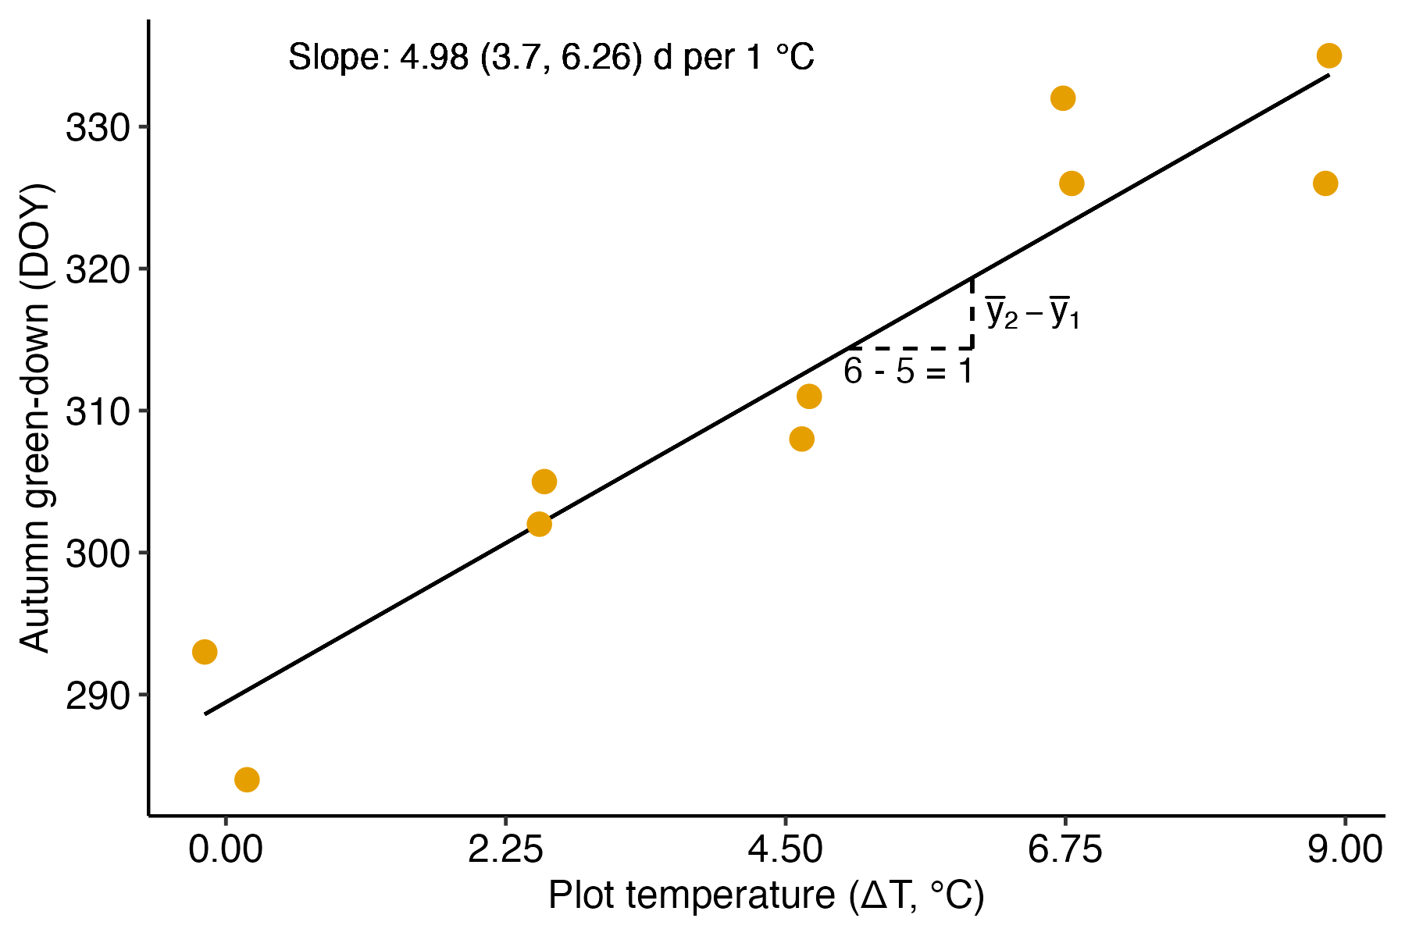
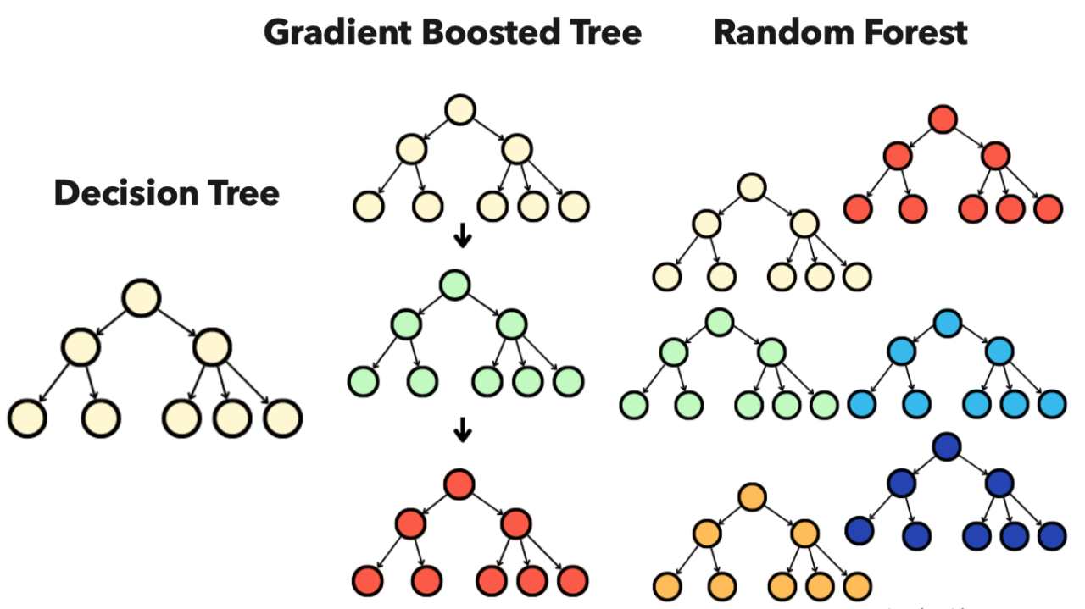
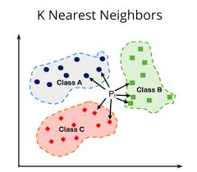
DAY 21 · DOMAIN-DRIVEN
Model Responses to Domain-Driven Features
Different models benefit differently
Linear Models
Tree-Based
Distance-Based
Most sensitive to representation
Engineered ratios dramatically improve fit and interpretability
Can approximate complex relationships
Domain features reduce depth, make splits meaningful
Rely on feature scales
Domain features create more meaningful distances
COMPARING MODEL FAMILIES
rf_raw = RandomForestRegressor().fit(X_raw, y); rf_dom = RandomForestRegressor().fit(X_domain, y)
knn_raw = KNeighborsRegressor(n_neighbors=3).fit(X_raw, y)
knn_dom = KNeighborsRegressor(n_neighbors=3).fit(X_domain, y)
print("RF raw:", rf_raw.score(...), "RF domain:", rf_dom.score(...))

Slide 10
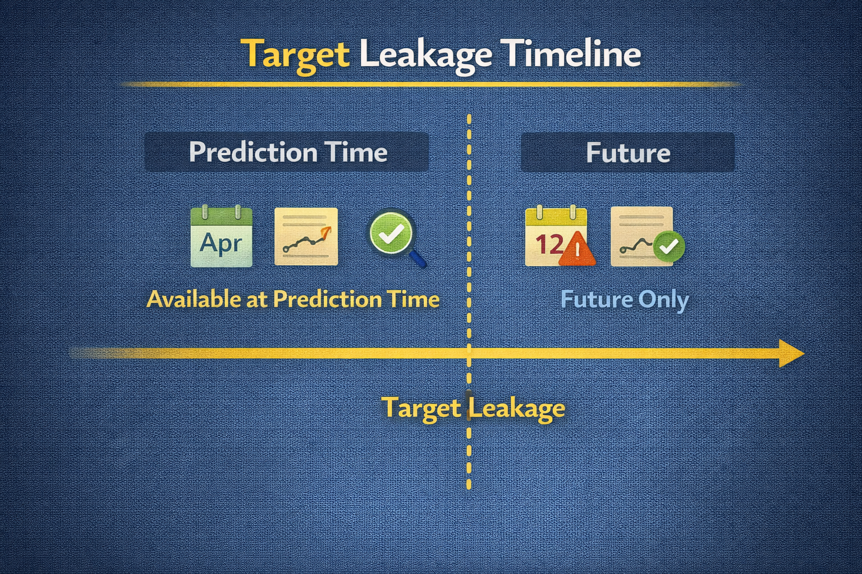
DAY 21 · DOMAIN-DRIVEN
Risks: Target Leakage, Overfitting, and Bias
Powerful features can introduce serious problems
Leakage Examples
Bias Concerns
• 'Average future price per customer' uses future info
• Complex ratios over small windows overfit to noise
• Post-outcome quantities in features
• Income per postal code proxies for protected attributes
• Domain knowledge itself can encode human biases
• Careful design, time-aware validation, bias audits needed
LEAKY VS SAFE FEATURES
# WRONG: Uses future_spend (not available at prediction time)
df["future_spend_ratio"] = df["future_spend"] / df["current_spend"]
# CORRECT: Only uses current or past information
df["current_spend_log"] = np.log1p(df["current_spend"])

Slide 11
DAY 21 · DOMAIN-DRIVEN
Validating Domain-Specific Features
Statistical and substantive checks
Statistical Validation
Substantive Validation
• Compare model performance with/without features
• Use proper cross-validation
• Inspect feature importances, coefficients
• Check partial dependence plots
• Verify with domain experts that patterns make sense
• Check against known constraints
• If metrics improve but patterns implausible → likely overfitting
CROSS-VALIDATION COMPARISON
from sklearn.model_selection import cross_val_score
scores_raw = cross_val_score(Ridge(alpha=1.0), X_raw, y, cv=5)
scores_domain = cross_val_score(Ridge(alpha=1.0), X_domain, y, cv=5)
print("CV mean raw:", scores_raw.mean(), "CV mean domain:", scores_domain.mean())

Slide 12
DAY 21 · DOMAIN-DRIVEN
When Domain Features Help or Hurt
Adding features isn't always beneficial
When They Help
When They Hurt
• Relationship is naturally expressed in ratio/rate
• Linear models need the transformation
• Feature aligns with how decisions are made
• Redundant with existing features → instability
• Encodes noise or spurious patterns
• Creates multicollinearity issues
• Requires regularization and thoughtful selection
REDUNDANCY CAN HURT
# Adding redundant features can destabilize models
print("R² with ratio only:", model_ratio.score(X_ratio, y))
print("R² with raw + ratio:", model_combined.score(X_combined, y)) # May be worse!

Slide 13
DAY 21 · ACTIVITY
Domain Feature Engineering Practice
Create price_per_sqft and extend the pattern
Activity Steps
Assessment
1. Create price_per_sqft from price and sqft
2. Handle edge cases (zero, missing sqft)
3. Inspect distribution of new feature
4. Propose 2+ additional domain-specific features
5. Compare models with/without domain features
6. Document intuition and risks for each
Written answers + code:
1. Why is price_per_sqft more informative than raw price?
2. Describe a leakage scenario for domain ratios
3. Compare linear vs random forest use of domain features
4. Propose a domain feature for different domain
(healthcare, finance)
SKELETON
df["price_per_sqft"] = df["price"] / df["sqft"].replace({0: np.nan})
df["price_per_sqft"] = df["price_per_sqft"].fillna(df["price_per_sqft"].median())
df["bedrooms_per_sqft"] = df["bedrooms"] / df["sqft"].replace({0: np.nan})

Slide 14
DAY 22
Interaction Features
Multiplicative, Additive, and Logical Combinations
OBJECTIVES
ACTIVITY
• Understand multiplicative, additive, logical interactions
• Capture conditional and non-linear structure
• Balance expressive power vs dimensionality
• Evaluate correlation vs usefulness
• Manage curse of dimensionality
Generate interaction features.
Analyze correlations with target.
ASSESSMENT
Justify which interactions should be retained based on data and domain.
Week 5 · Feature Engineering II

Slide 15
DAY 22 · INTERACTIONS
What Are Interaction Features?
Joint effects of two or more features
Definition
Why Needed
Constructed variables representing combined effects:
• feature_a * feature_b (multiplicative)
• feature_a + feature_b (additive)
• feature_a AND binary_flag (logical)
Effect of one variable depends on another
• Advertising spend more effective when site is fast
• Risk higher when both temperature AND pressure elevated
• Linear models can't capture this without explicit interactions
INTERACTION CAPTURING JOINT EFFECT
df["ad_spend_x_speed"] = df["ad_spend"] * df["site_speed"]
df["conversions"] = 0.001 * df["ad_spend_x_speed"] + noise # Target depends on interaction

Slide 16
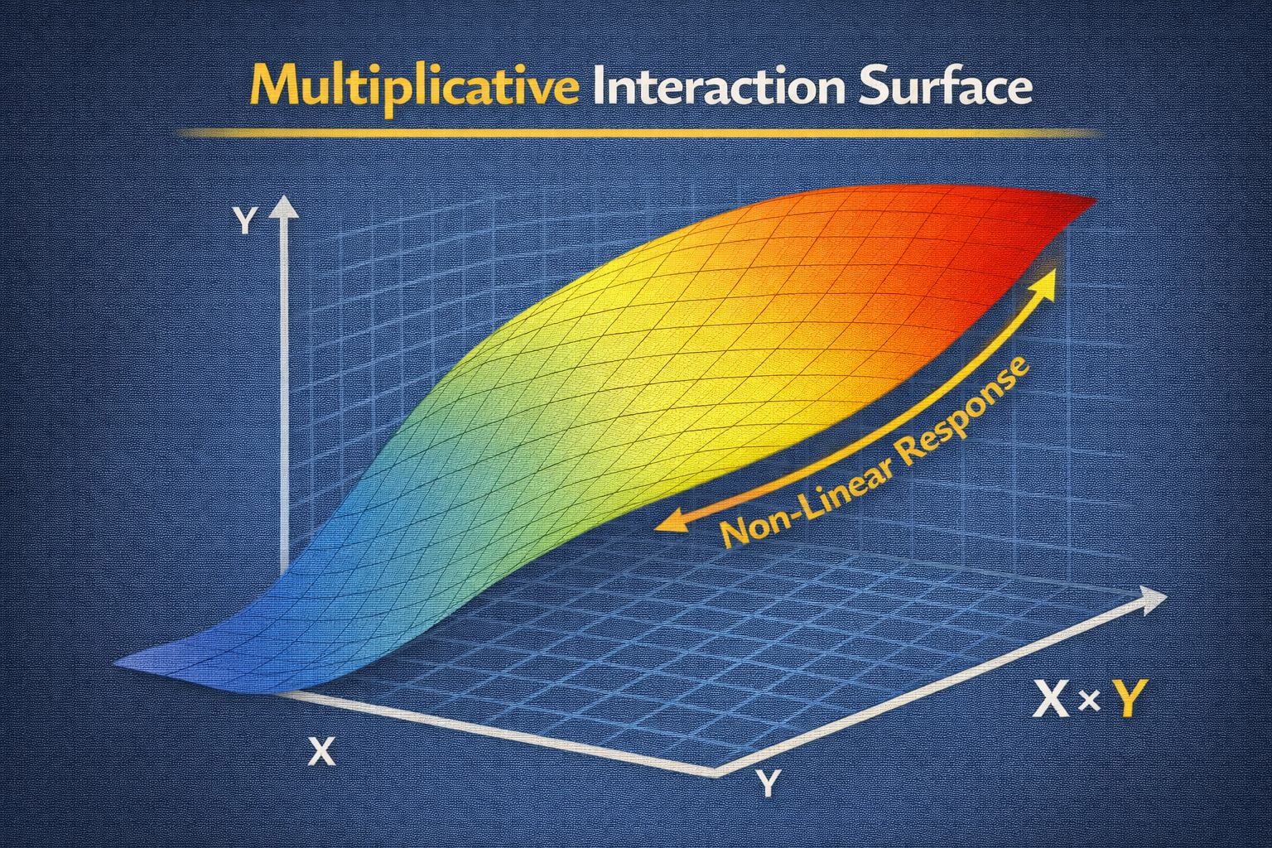
DAY 22 · INTERACTIONS
Multiplicative Interactions
Effect of one variable scales with another
Intuition
Benefits & Risks
• Risk scales with both load AND time under stress
• Revenue scales with both price AND quantity
• Coefficient of x1*x2 = how slope of x1 changes as x2 varies
• Introduce curvature into linear models
• Enable approximation of non-linearity
• Increase parameters, can exacerbate multicollinearity
MULTIPLICATIVE INTERACTION FOR FAILURE PREDICTION
df["load_time"] = df["load"] * df["time_under_stress"]
df["failure_score"] = 0.02 * df["load_time"] + noise
model_no_int = LinearRegression().fit(df[["load", "time_under_stress"]], y)
model_with_int = LinearRegression().fit(df[["load", "time_under_stress", "load_time"]], y)

Slide 17
DAY 22 · INTERACTIONS
Additive and Logical Interactions
Sums, differences, and conditional flags
Additive Interactions
Logical Interactions
• Sums: total exposure to multiple risk factors
• Differences: performance gaps, margins (revenue - cost)
• Centering before interactions reduces multicollinearity
• 'High risk if age > 60 AND smoker'
• 'Discount applies if is_member AND purchase > threshold'
• Encode business rules directly as binary indicators
ADDITIVE AND LOGICAL EXAMPLES
df["bp_sum"] = df["systolic_bp"] + df["diastolic_bp"]
df["bp_diff"] = df["systolic_bp"] - df["diastolic_bp"] # Pulse pressure
df["high_risk"] = ((df["age"] > 60) & (df["smoker"] == 1)).astype(int)

Slide 18
DAY 22 · INTERACTIONS
Capturing Non-Linear Relationships Manually
Center variables before multiplying
Technique
Result
• Center features (subtract mean) before forming interactions
• Product of centered variables introduces quadratic-like terms
• Logical indicators approximate step functions
• Model can represent surfaces that bend
• Approximates non-linear response surfaces
• Requires domain insight for meaningful interactions
CENTERED INTERACTION
df["temp_centered"] = df["temperature"] - df["temperature"].mean()
df["humidity_centered"] = df["humidity"] - df["humidity"].mean()
df["temp_x_humidity"] = df["temp_centered"] * df["humidity_centered"] # Non-linear joint effect

Slide 19
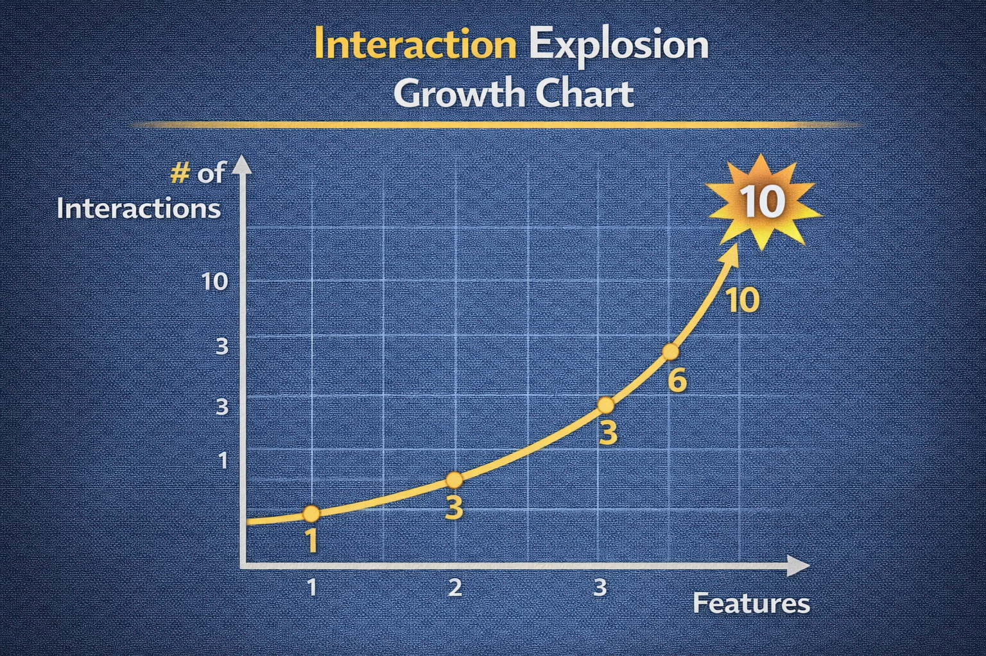
DAY 22 · INTERACTIONS
Curse of Dimensionality and Interaction Explosion
Naively generating all interactions is dangerous
The Problem
The Solution
• For d features: O(d²) pairwise, O(d^k) higher-order
• Memory, computation, overfitting all increase
• Distance metrics become less informative in high dimensions
• Guide by domain knowledge and EDA
• Don't blindly generate all interactions
• Use feature selection afterward
• Consider tree-based models that find interactions automatically
INTERACTION EXPLOSION EXAMPLE
from itertools import combinations
for f_a, f_b in combinations(["f1", "f2", "f3"], 2):
df[f"{f_a}_x_{f_b}"] = df[f_a] * df[f_b] # 3 features → 3 interactions, 100 → 4950!

Slide 20
DAY 22 · INTERACTIONS
Correlation vs Usefulness of Interactions
High correlation doesn't guarantee value
Correlation as Screening
Decision Process
• High correlation with target may indicate predictive potential
• Some interactions critical in combination even with low marginal correlation
• Highly correlated may duplicate existing information
• Use correlation for initial screening
• Must supplement with model-based evaluation
• Final decisions based on cross-validated performance
CORRELATION ANALYSIS
df["x1_x2"] = df["x1"] * df["x2"]
df["y"] = 0.1 * df["x1_x2"] + noise
corr_matrix = df[["x1", "x2", "x1_x2", "y"]].corr()
print(corr_matrix["y"]) # x1_x2 may have stronger correlation with y

Slide 21
DAY 22 · INTERACTIONS
Model Responses to Interaction Features
Different models leverage interactions differently
Linear Models
Tree-Based
Distance-Based
Cannot discover interactions
Explicit terms enable capturing conditional effects
Can discover interactions via splits
Explicit terms may reduce depth, improve stability
Interactions change distance geometry
Careful scaling needed
COMPARING MODEL FAMILIES WITH INTERACTIONS
linear_no_int = LinearRegression().fit(X_base, y)
linear_with_int = LinearRegression().fit(X_with_interactions, y)
rf = RandomForestRegressor().fit(X_base, y) # Can find interactions automatically
print("Linear R² base:", linear_no_int.score(...), "Linear R² int:", linear_with_int.score(...))

Slide 22
DAY 22 · INTERACTIONS
Implementation and Cross-Validation
Validate interactions empirically
Implementation Options
Cross-Validation
• Manual: df['a_x_b'] = df['a'] * df['b']
• sklearn PolynomialFeatures(interaction_only=True)
• Standardize in reusable functions
• Compare CV scores with/without interactions
• Ensure interactions generalize, not just fit training
• Guide retention decisions empirically
CROSS-VALIDATION FOR INTERACTION DECISION
from sklearn.model_selection import cross_val_score
scores_base = cross_val_score(Ridge(alpha=1.0), X_base, y, cv=5)
scores_int = cross_val_score(Ridge(alpha=1.0), X_with_interactions, y, cv=5)
print("CV without:", scores_base.mean(), "CV with:", scores_int.mean())

Slide 23
DAY 22 · ACTIVITY
Interaction Feature Practice
Generate and evaluate interaction features
Activity Steps
Assessment
1. Construct multiplicative interactions (key pairs)
2. Construct additive interactions (sums, differences)
3. Construct logical interactions (AND conditions)
4. Compute correlations with target
5. Build models with/without interactions
6. Identify most promising interactions and explain why
1. Real-world scenario needing multiplicative interaction?
2. Why is generating all pairwise interactions for 100 features problematic?
3. Compare linear vs random forest use of interactions
4. Procedure for deciding which interactions to keep?
SKELETON
df["f1_x_f2"] = df["feature1"] * df["feature2"]
df["f1_plus_f2"] = df["feature1"] + df["feature2"]
df["high_f1_and_flag"] = ((df["feature1"] > df["feature1"].median()) & (df["flag"] == 1)).astype(int)

Slide 24
DAY 23
Polynomial Features
Non-Linear Expansion for Linear Models
OBJECTIVES
ACTIVITY
• Understand why linear models fail on curved data
• Implement polynomial expansion with sklearn
• Balance degree selection (bias-variance)
• Manage feature explosion
• Apply regularization with polynomial features
Add polynomial terms to regression dataset.
Visualize fits of different degrees.
ASSESSMENT
When should polynomial features be used vs avoided?
Week 5 · Feature Engineering II

Slide 25
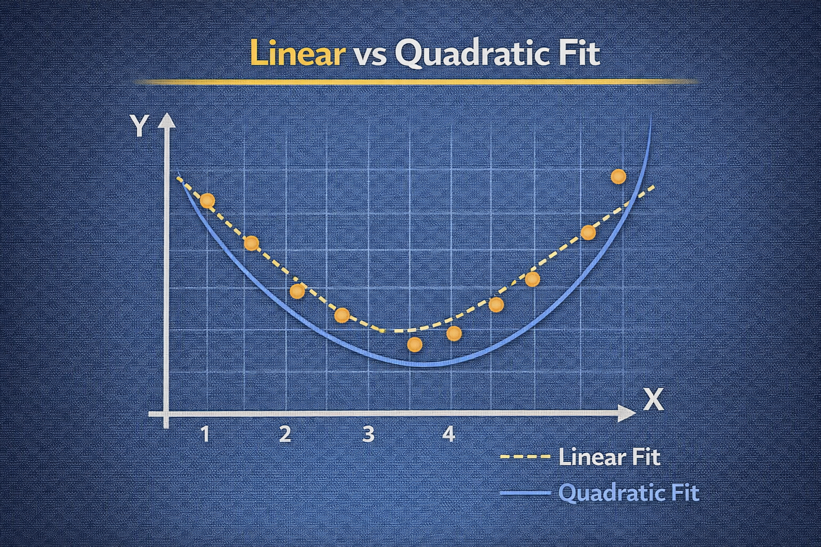
DAY 23 · POLYNOMIALS
Why Linear Models Fail on Non-Linear Data
Linear assumption causes systematic underfit
The Problem
The Solution
• Linear models assume weighted sum of inputs
• Curved relationships (quadratic, exponential) cause bias
• Fitting straight line to U-shape → large errors at curvature
• Augment features with powers and cross-terms
• Linear model in expanded space = polynomial in original
• Allows representing curves and surfaces
LINEAR MODEL ON QUADRATIC DATA
X = np.linspace(-3, 3, 20).reshape(-1, 1)
y = 0.5 * X[:, 0]**2 - X[:, 0] + 2 + noise
linear_model = LinearRegression().fit(X, y)
print("Linear coef:", linear_model.coef_) # Misses the curvature

Slide 26
DAY 23 · POLYNOMIALS
Polynomial Feature Expansion — Concept and Mechanics
Powers and products up to specified degree
How It Works
Effect
• Single feature x, degree 3: [1, x, x², x³]
• Multiple features: include cross-terms like x1*x2
• Linear model on expansion = polynomial function
• Changes hypothesis space from linear to polynomial
• Enables much richer approximations
• Degree controls complexity vs flexibility
PolynomialFeatures USAGE
from sklearn.preprocessing import PolynomialFeatures
poly = PolynomialFeatures(degree=3, include_bias=True)
X_poly = poly.fit_transform(X)
print("Original shape:", X.shape, "Expanded:", X_poly.shape)
print("Feature names:", poly.get_feature_names_out(["x"])) # [1, x, x^2, x^3]

Slide 27
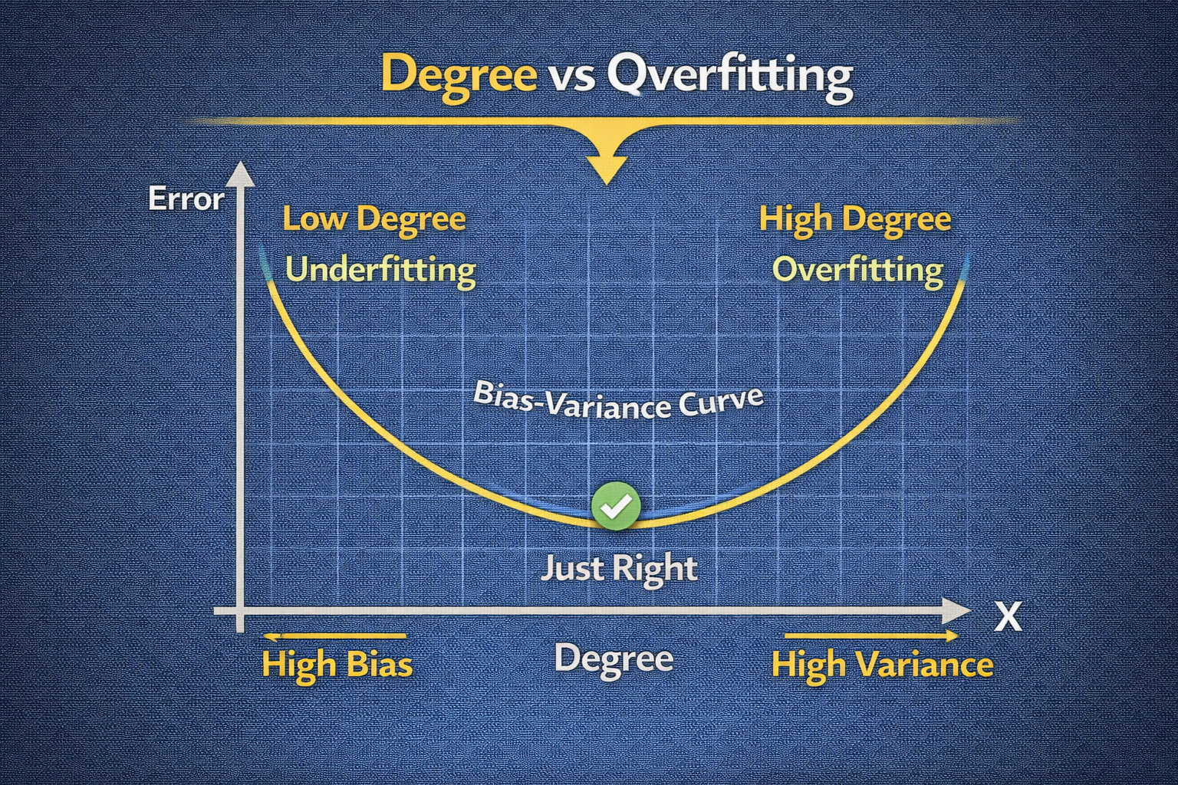
DAY 23 · POLYNOMIALS
Degree Selection — Bias-Variance Trade-Off
Choose simplest degree that fits well
Trade-Off
Selection Strategy
• Low degree (2, 3): broad curvature, may underfit
• High degree: can interpolate training data, overfits
• Features grow rapidly with degree and dimensions
• Cross-validation across degrees
• Prefer simplest model with similar validation score
• Consider regularization for higher degrees
DEGREE SWEEP WITH CROSS-VALIDATION
for d in [1, 2, 3, 5]:
poly = PolynomialFeatures(degree=d, include_bias=False)
X_poly = poly.fit_transform(X)
scores = cross_val_score(LinearRegression(), X_poly, y, cv=5)
print(f"Degree {d}, CV R²: {scores.mean():.3f} (std {scores.std():.3f})")

Slide 28
DAY 23 · POLYNOMIALS
Feature Explosion and Computational Cost
Dimensionality grows combinatorially
The Problem
Mitigation
• d features, degree k: combinatorial number of terms
• 5 features, degree 3: 56 terms
• Large, sparse matrices → memory, overfitting
• Apply polynomials to small subset of features
• Choose features with strong non-linear patterns
• Use regularization and feature selection
DIMENSIONALITY GROWTH
X_multi = np.random.randn(100, 5)
for degree in [2, 3]:
poly = PolynomialFeatures(degree=degree, include_bias=False)
X_poly = poly.fit_transform(X_multi)
print(f"Degree {degree}, original 5 → expanded {X_poly.shape[1]}")

Slide 29
DAY 23 · POLYNOMIALS
Regularization with Polynomial Features
Prevent overfitting at higher degrees
Why Regularization
Intuition
• High-degree polynomials can oscillate wildly
• Sensitive to small training data changes
• Ridge (L2): smooth solutions
• Lasso (L1): select subset of terms
• Model can fit flexible polynomials
• Regularization constrains to terms supported by data
• Choice of α is critical hyperparameter
RIDGE AND LASSO WITH POLYNOMIAL FEATURES
poly = PolynomialFeatures(degree=5, include_bias=False)
X_poly = poly.fit_transform(X)
ridge = Ridge(alpha=1.0).fit(X_poly, y)
lasso = Lasso(alpha=0.1, max_iter=10000).fit(X_poly, y)
print("Non-zero Lasso coefficients:", np.sum(lasso.coef_ != 0)) # Sparsity

Slide 30
DAY 23 · POLYNOMIALS
Model Family Responses to Polynomial Features
Different models benefit differently
Linear Models
Tree-Based
Distance-Based
Direct benefit - polynomial expansion enables curvature
Can approximate non-linearity without expansion
Polynomials often redundant
High-degree terms can dominate distances
Need careful scaling
COMPARING POLYNOMIAL VS NON-LINEAR MODELS
lin_poly = LinearRegression().fit(X_poly, y)
rf = RandomForestRegressor().fit(X, y) # No polynomial needed
knn = KNeighborsRegressor(n_neighbors=3).fit(X, y)
print("Linear+poly R²:", lin_poly.score(X_poly, y), "RF R²:", rf.score(X, y))

Slide 31
DAY 23 · ACTIVITY
Polynomial Feature Practice
Add polynomial terms and visualize fits
Activity Steps
Assessment
1. Create polynomial features of degrees 1, 2, 5
2. Fit linear models on each expanded feature set
3. Plot predictions vs true targets for each degree
4. Compare models with/without regularization
5. Observe overfitting at high degrees
6. Discuss when polynomial features help vs hurt
1. How does polynomial degree affect bias-variance?
2. Why does feature explosion matter for distance-based models?
3. How does regularization interact with polynomial features?
4. When would you prefer polynomial features over tree-based models?
VISUALIZATION SKELETON
for d in [1, 2, 5]:
poly = PolynomialFeatures(degree=d); X_poly = poly.fit_transform(X)
model = LinearRegression().fit(X_poly, y)
plt.plot(X_plot, model.predict(poly.transform(X_plot)), label=f"Degree {d}")

Slide 32
DAY 24
Feature Selection
Variance, Correlation, and Redundancy Removal
OBJECTIVES
ACTIVITY
• Understand why more features ≠ better models
• Implement variance thresholding
• Apply correlation-based selection
• Remove redundant features systematically
• Balance signal retention vs dimensionality
Remove low-variance and highly correlated features.
Compare model performance before/after.
ASSESSMENT
Justify selected feature set with statistical evidence and domain knowledge.
Week 5 · Feature Engineering II

Slide 33
DAY 24 · SELECTION
Why More Features ≠ Better Models
Complexity, overfitting, and noise
The Problem
The Solution
• More features → more complexity, overfitting risk
• Sparse data in high dimensions
• Noise features distract models into spurious patterns
• Feature selection focuses on informative variables
• Improves interpretability
• Reduces overfitting risk
• Often speeds up training and inference
NOISE FEATURES HURT PERFORMANCE
X_informative = np.random.randn(100, 2) # 2 true features
X_noise = np.random.randn(100, 20) # 20 noise features
X_all = np.hstack([X_informative, X_noise]) # Model must sort through all

Slide 34
DAY 24 · SELECTION
Curse of Dimensionality
High dimensions make learning harder
The Phenomenon
Impact by Model
• As features increase, data becomes sparse
• Distances between points become less meaningful
• Need exponentially more data to estimate reliably
• k-NN: distances uninformative in high-D
• Trees: need more samples for reliable splits
• Linear: more parameters to estimate
KNN IN 2D VS 50D (RANDOM DATA)
knn_2d = KNeighborsRegressor(n_neighbors=5)
knn_50d = KNeighborsRegressor(n_neighbors=5)
score_2d = cross_val_score(knn_2d, X_2d, y, cv=5).mean()
score_50d = cross_val_score(knn_50d, X_50d, y, cv=5).mean() # Usually much worse

Slide 35
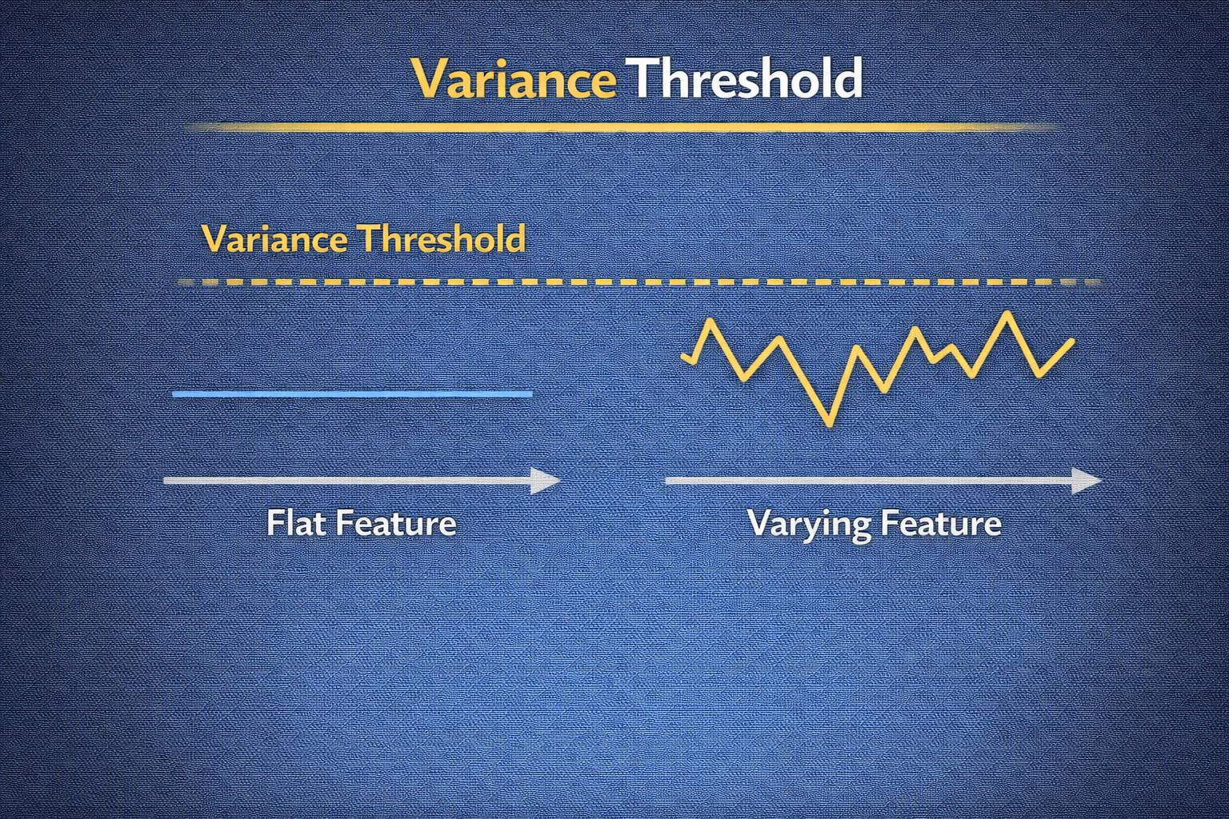
DAY 24 · SELECTION
Variance Thresholding
Remove features with near-constant values
Concept
Caveat
• Low-variance features carry little information
• Constant features contribute no predictive power
• Simple unsupervised technique applied first
• Some low-variance features capture rare but critical events
• Set threshold thoughtfully (small positive value)
• Consider domain importance
VARIANCE THRESHOLD IMPLEMENTATION
from sklearn.feature_selection import VarianceThreshold
df = pd.DataFrame({"const": [1,1,1,1,1], "low_var": [1,1,1,2,1], "high_var": [1,2,3,4,5]})
selector = VarianceThreshold(threshold=0.0)
X_selected = selector.fit_transform(df)
print("Kept mask:", selector.get_support()) # Drops const feature

Slide 36
DAY 24 · SELECTION
Correlation-Based Feature Selection
Identify features strongly associated with target
Target Correlation
Feature-Feature Correlation
• Features highly correlated with target have predictive potential
• Low correlation may indicate irrelevance
• Supplement with model-based evaluation
• Highly correlated features are redundant
• Keeping one from each pair simplifies model
• Works best for linear relationships
CORRELATION ANALYSIS
df["x2"] = df["x1"] + np.random.normal(0, 0.01, size=100) # Highly correlated
df["y"] = 2 * df["x1"] + noise
corr = df.corr()
print(corr) # x1 and x2 redundant; either can represent signal

Slide 37
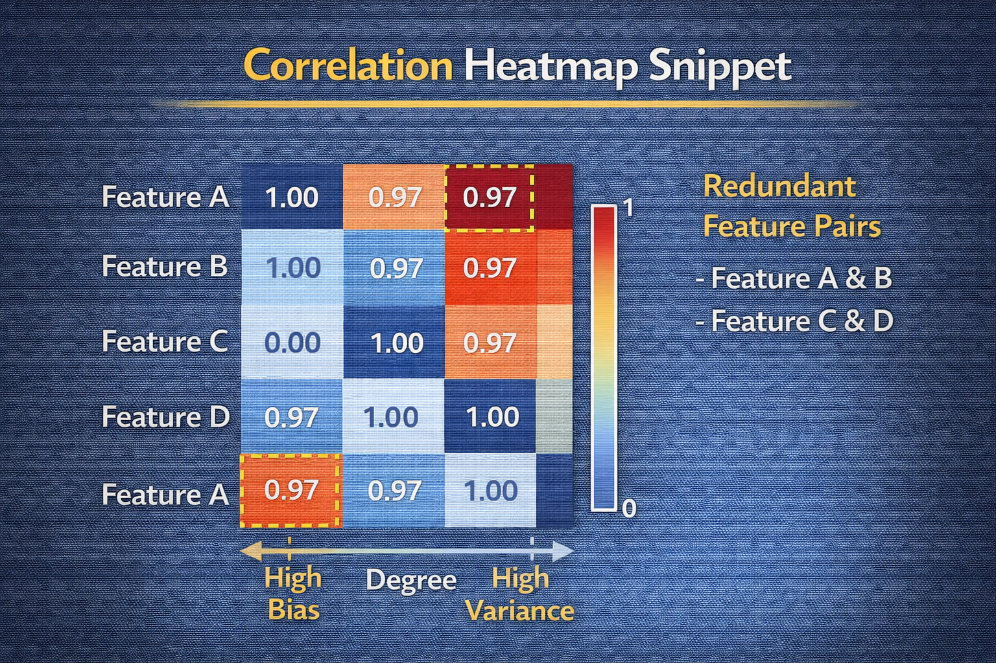
DAY 24 · SELECTION
Redundant Feature Removal in Practice
Systematically drop highly correlated features
Process
Decision Criteria
1. Compute correlation matrix
2. Identify pairs above threshold (e.g., 0.9)
3. Drop one from each pair (lower quality or target corr)
4. Reduces multicollinearity, simplifies model
• More missing values → drop
• Lower correlation with target → drop
• Less interpretable → drop
REDUNDANCY REMOVAL FUNCTION
def drop_correlated_features(df, threshold=0.9):
corr_matrix = df.corr().abs()
upper = corr_matrix.where(np.triu(np.ones(corr_matrix.shape), k=1).astype(bool))
to_drop = [col for col in upper.columns if any(upper[col] > threshold)]
return df.drop(columns=to_drop), to_drop

Slide 38
DAY 24 · SELECTION
Feature Selection vs Feature Engineering
Related but distinct processes
Feature Engineering
Feature Selection
• Creates new features from raw data
• Captures domain-relevant structure
• Adds to feature universe
• Chooses subset of features (raw or engineered)
• Acts as filter and regularizer
• Not a substitute for good engineering
ENGINEER THEN SELECT
df["x_sq"] = df["x"] ** 2 # Engineering: create feature
df["noise"] = np.random.randn(100) # Noise feature
selector = SelectKBest(score_func=f_regression, k=2)
X_selected = selector.fit_transform(df[["x", "x_sq", "noise"]], y) # Selection: keep best

Slide 39
DAY 24 · SELECTION
Model Stability and Generalization
Fewer, better features improve robustness
Benefits
Risk of Over-Selection
• More stable coefficients across CV folds
• More consistent performance
• Focus on robust patterns, not noise idiosyncrasies
• Aggressive selection may remove weak but complementary signals
• Tune selection threshold carefully
• Evaluate on held-out data
COMPARING FULL VS SELECTED FEATURES
model_full = Ridge(alpha=1.0); scores_full = cross_val_score(model_full, X, y, cv=5)
X_selected = X[:, :5] # Assume first 5 are informative
model_selected = Ridge(alpha=1.0); scores_selected = cross_val_score(model_selected, X_selected, y, cv=5)
print("Full CV R²:", scores_full.mean(), "Selected CV R²:", scores_selected.mean())

Slide 40
DAY 24 · ACTIVITY
Feature Selection Practice
Variance threshold and correlation filtering
Activity Steps
Assessment
1. Apply VarianceThreshold to remove near-constant features
2. Compute correlation matrix
3. Implement drop_correlated_features() function
4. Apply correlation filter (threshold 0.9)
5. Compare Ridge performance before/after selection
6. Document which features removed and why
1. Why are constant features rarely useful?
2. Procedure for correlation-based redundancy removal?
3. How does selection differ for linear vs tree models?
4. Explain curse of dimensionality and how selection helps
SKELETON
var_selector = VarianceThreshold(threshold=0.01).fit(X_train)
X_train_var = var_selector.transform(X_train)
X_reduced, dropped = drop_correlated_features(X_train_var_df, threshold=0.9)

Slide 41
DAY 25
Feature Engineering Mini-Project
End-to-End Workflow with Documentation
OBJECTIVES
ACTIVITY
• Apply full feature engineering workflow
• Integrate domain, interactions, polynomials, selection
• Guard against leakage explicitly
• Address ethical considerations
• Prepare features for production
Engineer robust feature set from cleaned dataset.
Document all decisions with rationale.
ASSESSMENT
Graded GitHub submission with code, data, and documentation.
Week 5 · Feature Engineering II

Slide 42
DAY 25 · MINI-PROJECT
Designing an End-to-End Plan
Plan before coding
Plan Components
Evaluation Plan
• Understand prediction task
• Identify important domain quantities
• Choose candidate transformations
• Plan feature selection strategy
• Specify leakage prevention measures
• Cross-validation strategy
• Feature importance analysis
• Fairness and ethical review
• Document assumptions throughout
FEATURE ENGINEERING PLAN
plan = {"domain_features": ["per_unit_ratios"], "interactions": ["key_pairs"],
"polynomial_terms": ["selected_degree_2"], "selection": ["variance", "correlation"],
"leakage_checks": ["no_future_info"], "fairness": ["review_proxy_features"]}

Slide 43
DAY 25 · MINI-PROJECT
Applying Domain-Driven Features
Meaningful ratios and per-unit metrics
Implementation
Documentation
• Compute price_per_sqft, revenue_per_user, etc.
• Handle division by zero safely
• Document rationale for each feature
• What real-world quantity it represents
• How it relates to target
• Expected model impact
DOMAIN FEATURES IN PROJECT
df_features = df.copy()
df_features["price_per_sqft"] = df["price"] / df["sqft"].replace({0: np.nan})
df_features["price_per_sqft"] = df_features["price_per_sqft"].fillna(df_features["price_per_sqft"].median())
df_features["revenue_per_user"] = df["revenue"] / df["num_users"].replace({0: np.nan})

Slide 44
DAY 25 · MINI-PROJECT
Engineering Interactions and Polynomials
Thoughtful, limited expansion
Interaction Strategy
Polynomial Strategy
• Limited set based on domain insight
• Key numeric pairs (multiplicative)
• Important conditions (logical)
• Selective application to few variables
• Degree 2 for variables with plausible non-linearity
• Requires regularization
INTERACTIONS AND POLYNOMIALS IN PROJECT
df_features["f1_x_f2"] = df_features["feature1"] * df_features["feature2"]
df_features["high_risk"] = ((df_features["age"] > 60) & (df_features["is_smoker"] == 1)).astype(int)
# Polynomial on selected variables
poly = PolynomialFeatures(degree=2, include_bias=False)
X_poly = poly.fit_transform(df_features[["age", "price_per_sqft"]])

Slide 45
DAY 25 · MINI-PROJECT
Guarding Against Target Leakage
Critical for valid evaluation
Leakage Sources
Prevention
• Features using future information
• Aggregates including post-outcome records
• Ratios with target-derived quantities
• Scaling parameters from combined train+test
• Review every feature definition
• Fit transformers on training only
• Use proper train/test split before any engineering
• Document time-based validity
LEAKAGE-SAFE SCALING
X_train, X_test, y_train, y_test = train_test_split(X, y, test_size=0.2)
scaler = StandardScaler()
X_train_scaled = scaler.fit_transform(X_train) # Fit on train only
X_test_scaled = scaler.transform(X_test) # Transform test

Slide 46
DAY 25 · MINI-PROJECT
Feature Selection in the Project
Pare down expanded feature space
After Engineering
Process
• Feature space may be large and redundant
• Polynomial and interaction terms proliferate
• Selection creates compact, informative set
1. Variance thresholding
2. Correlation-based redundancy removal
3. Compare model performance
4. Document selections and rationale
SELECTION PIPELINE
var_selector = VarianceThreshold(threshold=0.01)
X_train_var = var_selector.fit_transform(X_train_num)
X_train_reduced, dropped = drop_correlated(X_train_var_df, threshold=0.95)
print("Original:", len(numeric_cols), "After variance:", X_train_var.shape[1], "After corr:", X_train_reduced.shape[1])

Slide 47
DAY 25 · MINI-PROJECT
Ethical Considerations in Feature Design
Fairness, privacy, and potential harms
Key Concerns
Mitigations
• Features acting as proxies for protected attributes
• Postal codes, income may correlate with race/gender
• Can embed and amplify biases
• Review each feature for fairness issues
• Consider necessity and proportionality
• Conduct fairness audits on model predictions
• Document justifications
IDENTIFYING POTENTIAL PROXY FEATURES
sensitive_proxies = [col for col in df_features.columns if "zip" in col.lower() or "income" in col.lower()]
print("Potential proxy features for review:", sensitive_proxies)

Slide 48
DAY 25 · MINI-PROJECT
Preparing Features for Production
Reproducible, versioned, monitored
Requirements
Monitoring
• Encapsulate transformations in pipelines
• Handle missing values consistently
• Maintain column ordering
• Version external dependencies
• Detect data drift over time
• Log feature distributions
• Alert on unexpected values
PRODUCTION PIPELINE
from sklearn.pipeline import Pipeline
from sklearn.compose import ColumnTransformer
preprocess = ColumnTransformer(transformers=[
("num", Pipeline([("imputer", SimpleImputer(strategy="median")), ("scaler", StandardScaler())]), numeric_features)])
final_model = Pipeline([("preprocess", preprocess), ("model", RandomForestRegressor())])

Slide 49
DAY 25 · MINI-PROJECT
Model Training with Engineered Features
Compare with and without advanced features
Training Strategy
Interpretation
• Train multiple model families (linear, tree)
• Compare performance with/without engineering
• Demonstrate value of your features
• Analyze feature importances
• Inspect coefficients
• Relate back to domain intuition
MODEL COMPARISON
ridge = Ridge(alpha=1.0).fit(X_train_final, y_train)
rf = RandomForestRegressor(random_state=0).fit(X_train_final, y_train)
print("Ridge R²:", r2_score(y_test, ridge.predict(X_test_final)))
print("RF R²:", r2_score(y_test, rf.predict(X_test_final)))

Slide 50
DAY 25 · ACTIVITY
Full Feature Engineering Submission
End-to-end workflow with documentation
Deliverables
Assessment Checklist
1. Cleaned input data + engineered feature dataset
2. Reproducible feature engineering pipeline
- Domain features, interactions, polynomials
- Feature selection
3. Documentation explaining:
- Domain intuition for each feature type
- Leakage prevention measures
- Ethical considerations
4. Evaluation comparing models with/without features
□ Repository with cleaned + engineered data
□ Code implements reproducible pipeline
□ Documentation explains domain intuition
□ Evaluation compares with/without features
□ Reflection discusses leakage, selection, ethics
Submit GitHub repository URL.

Slide 51
Week 5 Complete!
Feature Engineering II — From Expert Knowledge to Production
Domain-Driven
Ratio features, per-unit metrics, business logic; validate empirically; avoid leakage
Interactions
Multiplicative, additive, logical; expand hypothesis space; manage dimensionality
Polynomials
Non-linear for linear models; degree selection; regularization essential
Selection
Variance threshold, correlation filter; reduce overfitting; improve stability
Mini-Project
End-to-end pipeline; documentation; ethical review; production-ready
Key Takeaway
Feature engineering transforms raw data into meaningful representations. Document decisions, validate empirically, guard against leakage, and consider ethical implications at every step.
PATTERN TO CARRY FORWARD
engineer_features(df) → domain_ratios() → interactions() → polynomials() → select_features() → validate() → document()

